Slide 1

ESQC 2026
Mathematical Methods Lecture 2
By Simen Kvaal

Slide 2
Today’s agenda:
More on matrices and linear transformations
Linear systems of equations
Matrix decompoisitions

Slide 3
Brief recap
From yesterday

Slide 4

The matrix-vector product
A matrix and a vector can be multiplied together
Notes:
A(\mathbf{x})_i = \sum_{j=1}^n A_{ij} x_j
A = \begin{bmatrix} A_{11} & A_{12} & \cdots & A_{1n} \\
A_{21} & A_{22} & \cdots & A_{2n} \\
\vdots & \vdots & \ddots & \vdots \\
A_{m1} & A_{m2} & \cdots & A_{mn} \end{bmatrix}

Slide 5


Matrix-matrix product
Note 1:
Note 2: A ⨉ a column of B = a column of C
Notes:
\begin{bmatrix} A_{11} & A_{12} & \cdots & A_{1n} \\
A_{21} & A_{22} & \cdots & A_{2n} \\
\vdots & \vdots & \ddots & \vdots \\
A_{m1} & A_{m2} & \cdots & A_{mn} \end{bmatrix} \begin{bmatrix} B_{11} & B_{12} & \cdots & B_{1o} \\
B_{21} & B_{22} & \cdots & B_{2o} \\
\vdots & \vdots & \ddots & \vdots \\
B_{n1} & B_{n2} & \cdots & B_{no} \end{bmatrix} = \begin{bmatrix} C_{11} & C_{12} & \cdots & C_{1o} \\
C_{21} & C_{22} & \cdots & C_{2o} \\
\vdots & \vdots & \ddots & \vdots \\
C_{m1} & C_{m2} & \cdots & C_{mo} \end{bmatrix}

Slide 6
Matrices = linear transformations
The matrix-vector product is linear
Therefore it defines a linear transformation (from n to m dimensions)
Conversely, any linear transformation can be written as a matrix-vector product
A powerful result!
Notes:
A matrMatriu

Slide 7
The matrix of a linear transformation
Recall: n-dimensional space has infinitely many bases
The definition of a linear transformation does not rely on a basis
Once a basis is chosen the linear transformation beomes a matrix

Slide 8
The matrix zoo

Slide 9
The matrix zoo
Matrices contain a lot of information!
Can we tame that information?
Usually, we are interested in special problems:
Define important classes of matrices with common properties
For a given matrix, try to say as much as possible about it
Study decompositions of matrices in terms of simpler matrices
We will now look at some classes of matrices

Slide 10
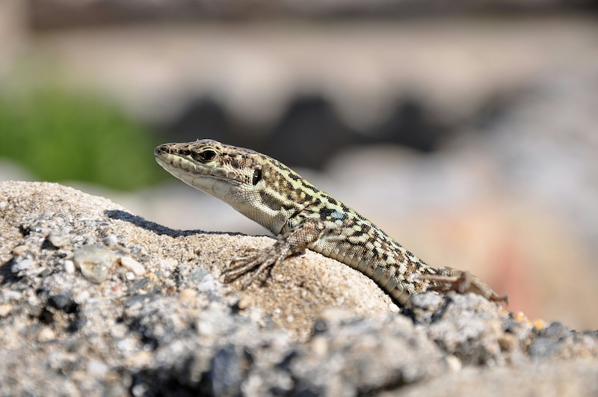


Important matrix operations
Sometimes we need rows and columns to switch place
Transpose:
Hermitian adjoint:
Notes:
(A^T)_{ij} = A_{ji} \qquad \begin{bmatrix} 0 & 1 \\ \rmi & 2 \\ 0 & -1 \end{bmatrix}^T = \begin{bmatrix} 0 & \rmi & 0 \\ 1 & 2 & -1 \end{bmatrix}

Slide 11
Why this operation?
Real case
Complex case
Notes:
(A^T)_{ij} = A_{ji} \qquad \begin{bmatrix} 0 & 1 \\ \rmi & 2 \\ 0 & -1 \end{bmatrix}^T = \begin{bmatrix} 0 & \rmi & 0 \\ 1 & 2 & -1 \end{bmatrix}

Slide 12
Class 1: Symmetric matrices
Square matrices that are their own transpose

Slide 13
Class 2: Hermitian matrices (complex)
Square matrices that are their own conjugate transpose

Slide 14
Hermitian matrices can be «diagonalized»
Let A be Hermitian (real case: symmetric)
Consider the eigenvalue problem:
An orthonormal basis of eigenvectors exist
A becomes very simple in this basis:
Demo: lecture-2-diagonalization.py

Slide 15
The identity matrix is special
We need a small aside ...
The identity matrix defines the «do nothing»-transformation:

Slide 16
Class 3: Unitary/orthogonal matrices
Char. 1: Matrices that satisfy:
Char. 2: Columns form orthonormal basis:
Char. 3: Matrices that preserve orthogonality of vectors
Real case: «orthogonal», complex case: «unitary»

Slide 17
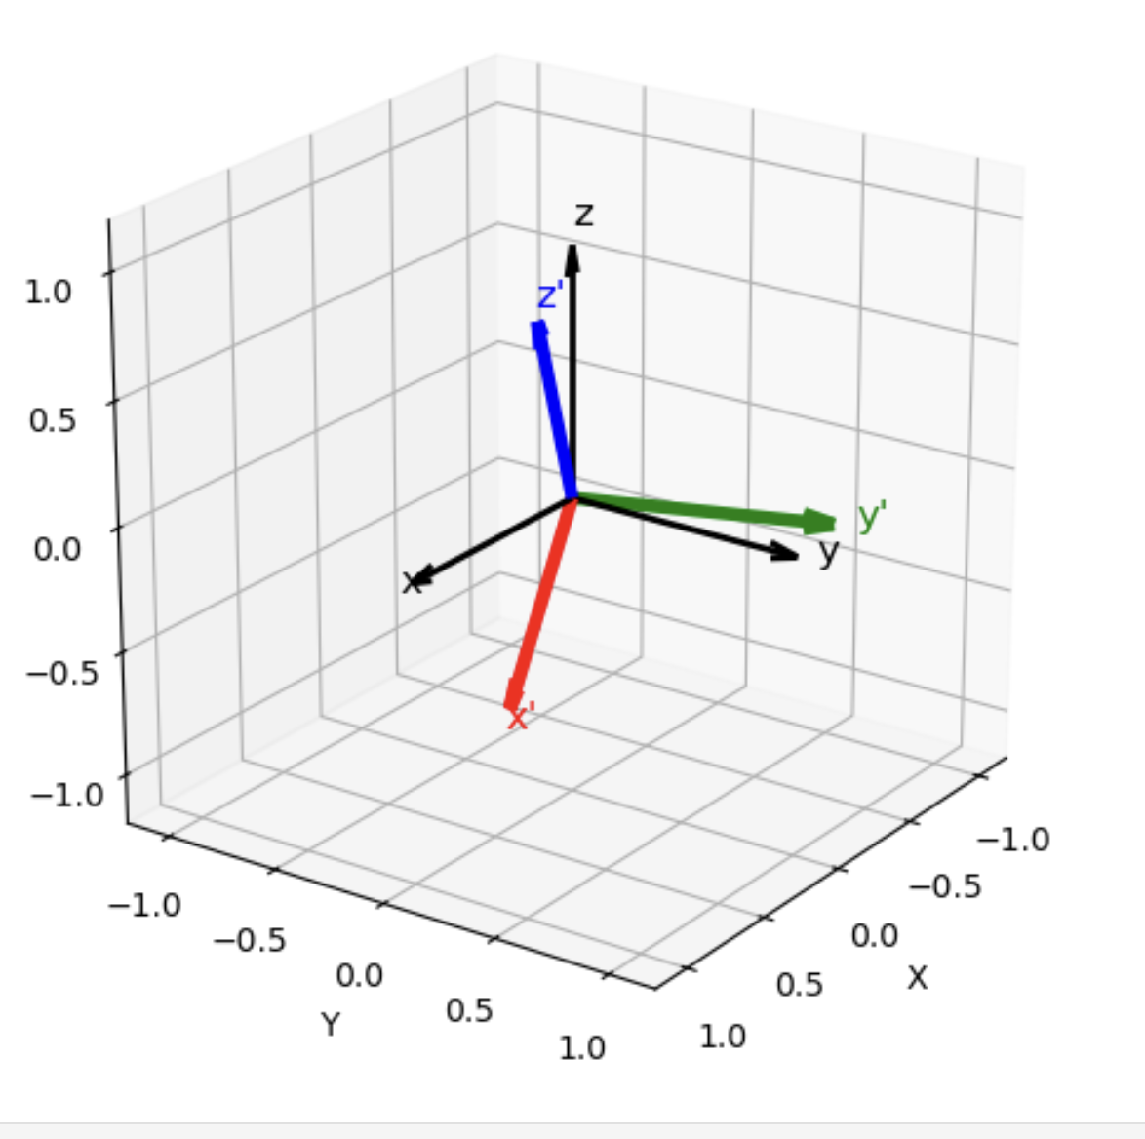
Demo
Rotation in 3D
lecture-1-interactive-rotation.ipynb

Slide 18
Linear systems of equations
Given b, determine x such that:
Linear systems are everywhere in science
Example: Balancing reactions

Slide 19
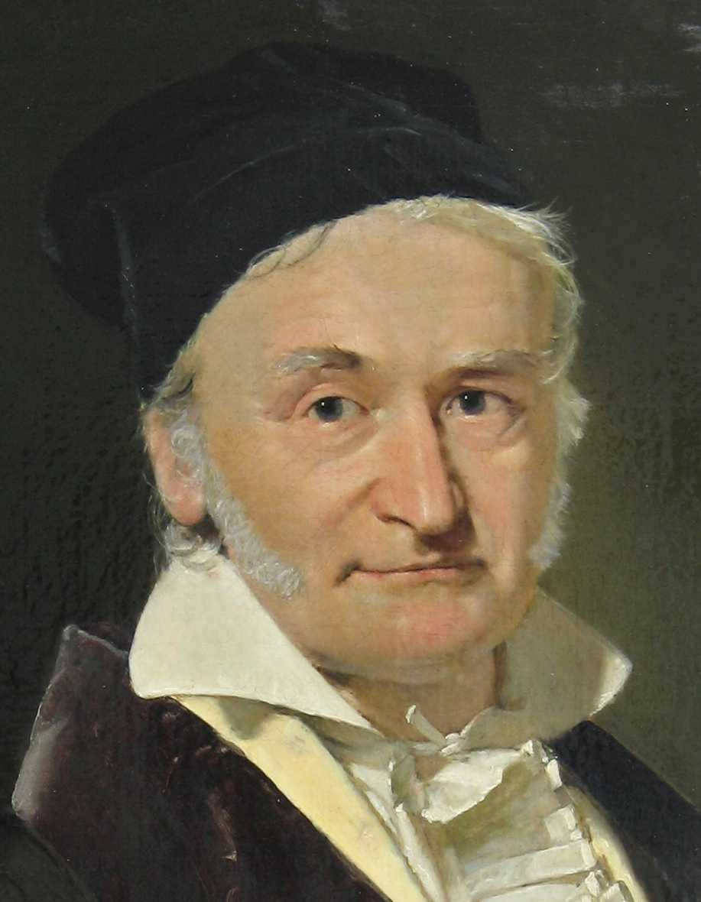
Gaussian elimination
Yes, almost everything is named after me, or should be
A method for solving linear systems
Read about it in the lecture notes!
Or watch some high-quality videos, e.g. https://www.youtube.com/watch?v=2GKESu5atVQ (MyWhyU)
Of course, there is
x = np.linalg.solve(A, b)

Slide 20
Class 4: Invertible matrices
If A is such that solution is unique ⇒ existence of inverse matrix
Example: Inverse of plane rotation matrix
Non-existence of inverse: A is singular (e.g., balancing equation)
Inverse given by opposite rotation

Slide 21
Matrix decompositions
Simplifying matrices with simpler matrices

Slide 22
Hermitian A: spectral decomposition
We already saw that for Hermitian A, had an orthonormal basis of eigenvectors as solution
Then:
Demo: Back to diagonalization notebook
Unitary
Diagonal

Slide 23
Many matrices can be «diagonalized»
It may be so that with a basis of eigenvectors – but possibly non-orthonormal
Then:
Eigendecomposition
Invertible
Diagonal

Slide 24
Singular value decomposition (SVD):
For any matrix, even non-square, we have the SVD:
Exists unitary matrices U, V
and diagonal Σ with positive entries
Interpretation:
1. Express x in the basis defined by V
3. Tranform to new basis given by U
2. Stretch the components

Slide 25
Illustration from Wikipedia (user Georg-Johann), modified by me

Slide 26
SVD continued
Demo: lecture-2-svd-of-image.ipynb
In which we view the parrot as a matrix – not as a vector ...
Relevance in quantum chemistry:
Screening of electron repulsion integrals
Orthogonalization of orbitals
...

Slide 27
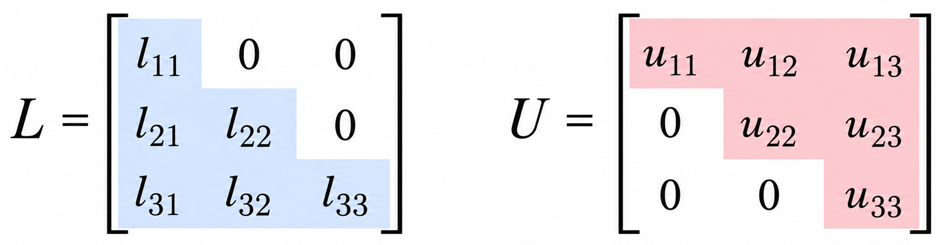
LU decomposition
In general very expensive!
We want to solve a linear system:
Under a mild technical condition on A there is a factorization
This makes repeated solves with different b super fast!
Gaussian elimination written as a matrix decoposition
Lower triangular
Upper triangular

Slide 28
Cholesky decomposition
In many applications A satisfies:
Hermitian:
positive definite:
Then LU simplifies:
Cholesky decomposition

Slide 29
An application of Cholesky
The electron repulsion integral tensor is costly to store and compute
View the tensor as a matrix, which is Hermitian and positive definite:
V can be well approximated by an incomplete Cholesky factorization!
Demo: lecture-2-eri_svd_cholesky.ipynb
N_{AO}⁴ elements
~ N_{AO}² elements

Slide 30
End of lecture 2

